Slide 1

Firewall Configuration and Optimization
Findings Summarize Report

Slide 2


UFW – Uncomplicated firewall
What is UFW ?
UFW is an easy-to-use frontend for managing Iptables firewall rules on a Linux system. It simplifies firewall configuration and is commonly used on Debian-based systems, including Kali Linux.

Slide 3
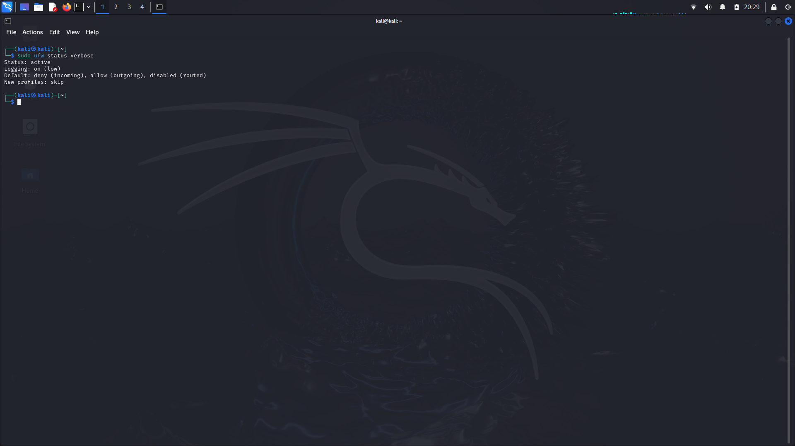
Current firwall configuration
To review the current configuration we have to follow some command such as,
sudo ufw status : to check the status of firwall wether the firewall is active or inactive
sudo ufw status verbose : to check the current configuration of firewall with rules and logging
sudo ufw status numbered : this command show us the rules in number so that it will be easy to understand which rule has specific number

Slide 4
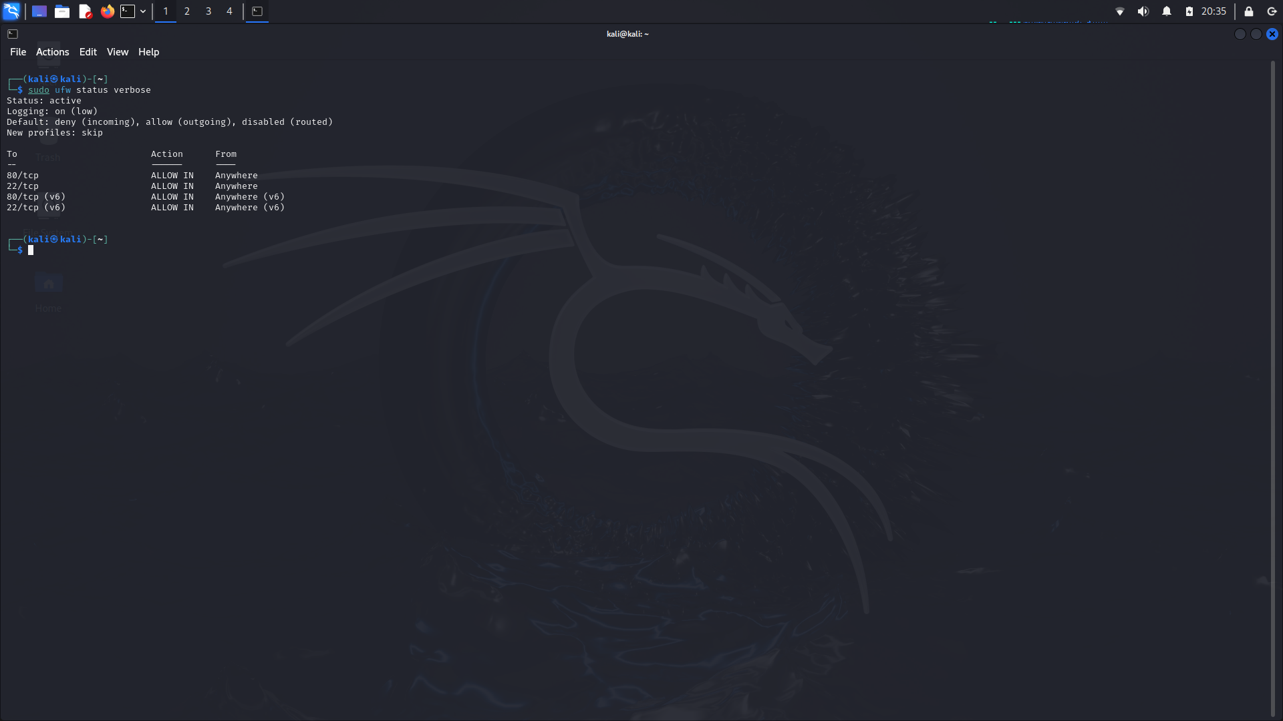
Finding Potential Vulnerability
To find the potential vulnerability we have to analyze the current configuration
We analyze and found
Overly Permissive Rules
Issue: Rules allowing traffic on ports 22 (SSH), 80 (HTTP), and 443 (HTTPS) from any source.
Risk: These rules could expose the system to unauthorized access and attacks
Logging Configuration
Issue: Logging is set to a low level.
Risk: Important security events may not be logged, making it difficult to detect and respond to potential threats.
Default Policy
Issue: The default outgoing policy is set to allow.
Risk: Outbound traffic is not restricted, which could allow malware or unauthorized data exfiltration

Slide 5


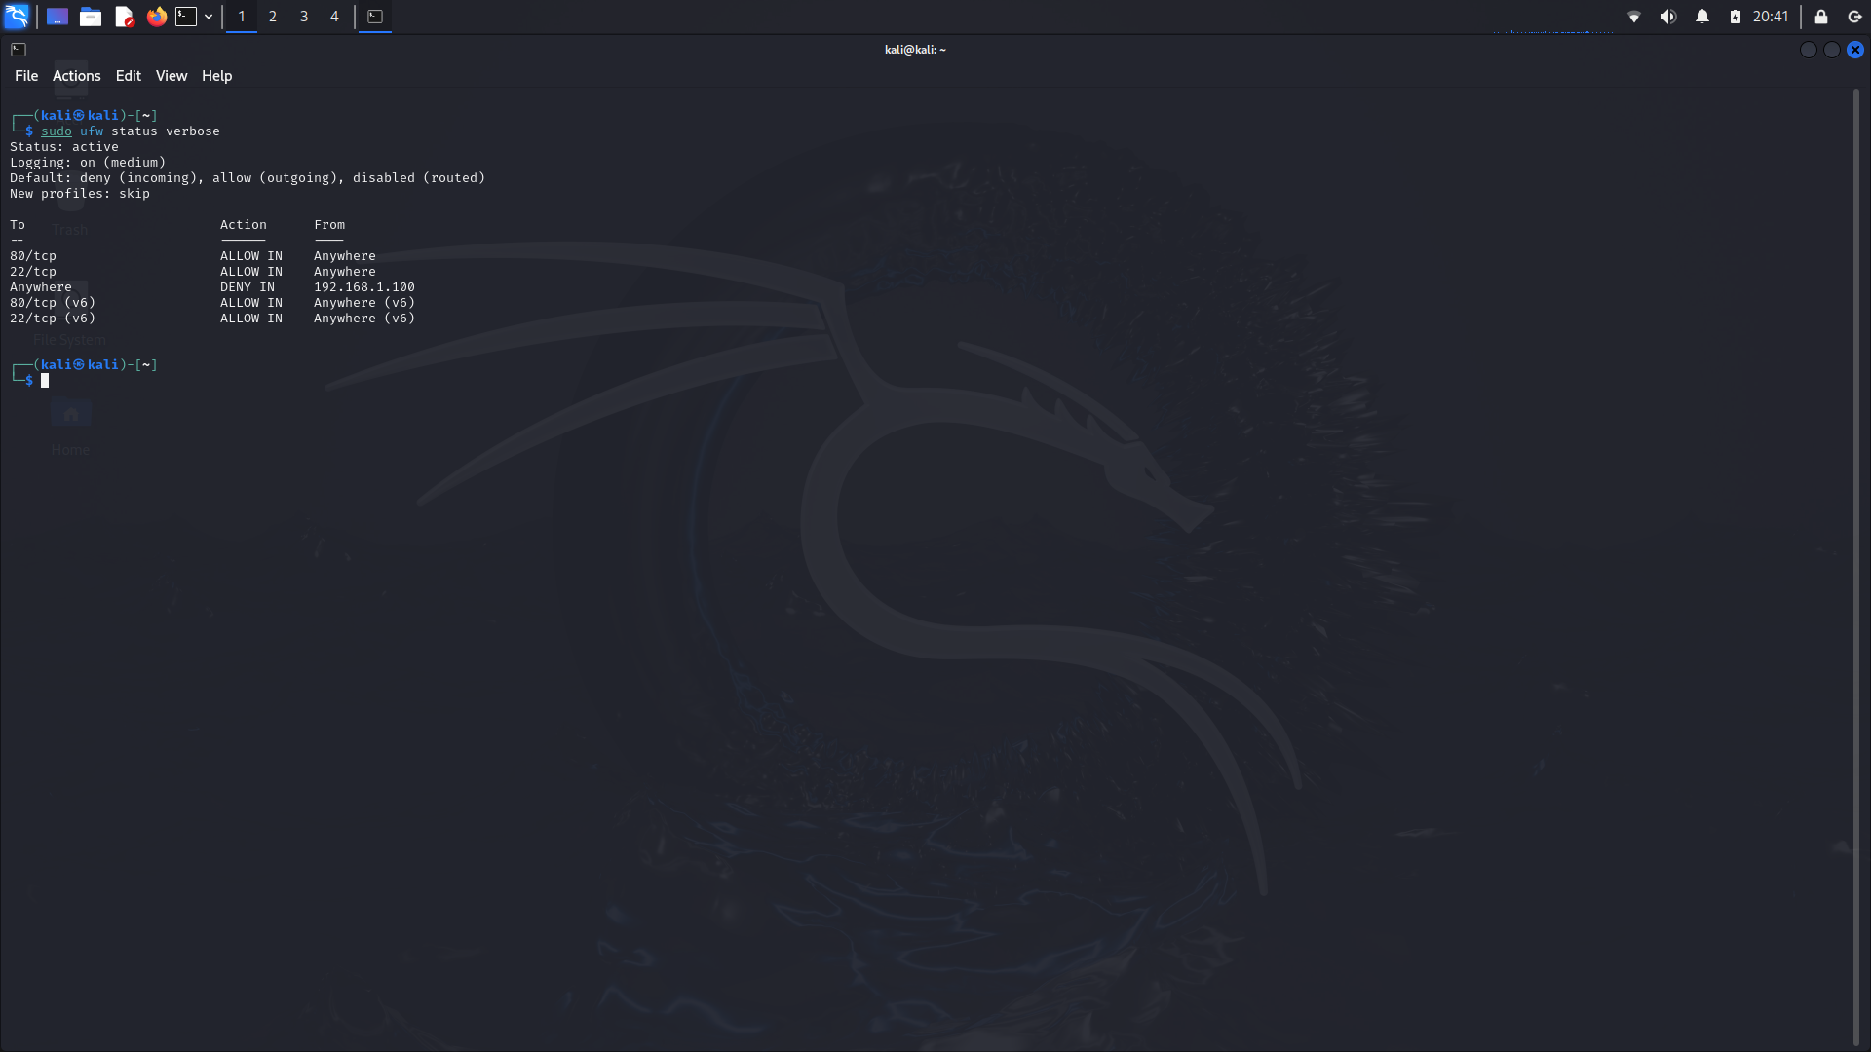
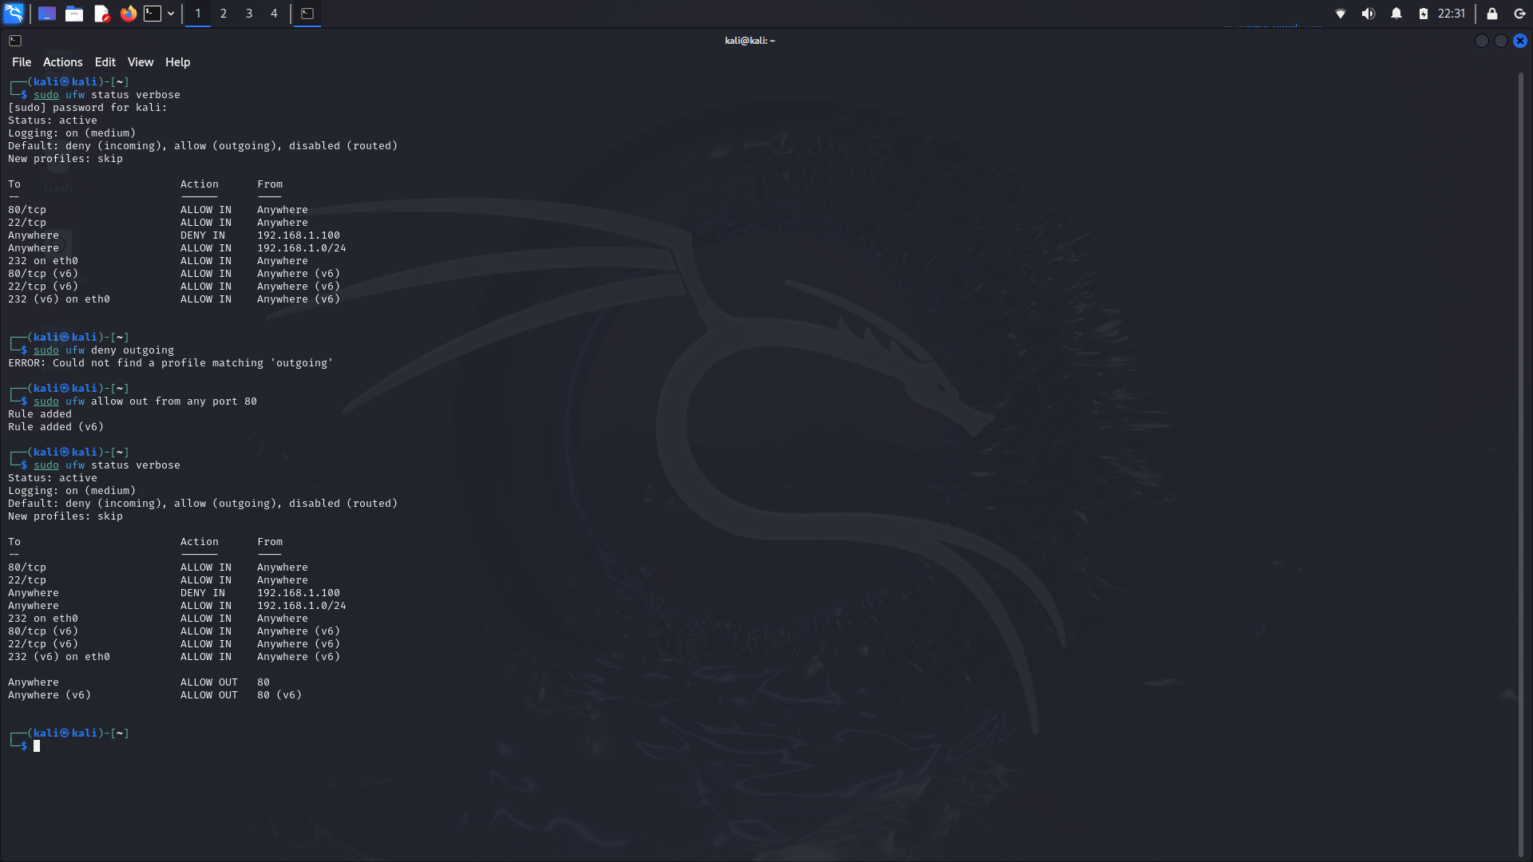
Optimizing Firewall Configurations
Rule Optimization
Restrict SSH Access:
Allow SSH access only from specific IP addresses or networks.
Restrict HTTP/HTTPS Access
Allow HTTP/HTTPS access only if necessary, and restrict to trusted sources where possible
Logging Configuration
Increase Logging Level
Set logging to a higher level to capture more detailed information.
Default Policy
Restrict Outbound Traffic:
Set default policy to deny outgoing traffic and create specific allow rules as needed

Slide 6

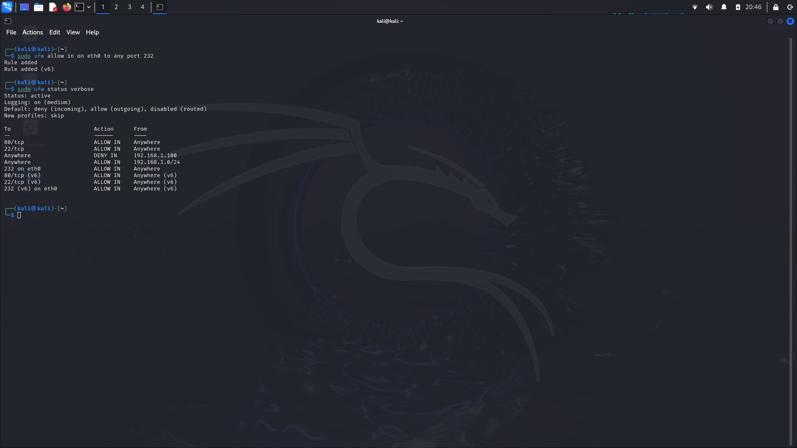
Conclusion
By solving identified problems and implementing recommendations, organizations can improve network security. Periodic screening, monitoring and training of personnel ensures that personnel are prepared to respond to future threats

Slide 7
Thank you
Present by: Kushagra Pandurang Pitre
Intern :andintern
contact.:+91 9766695361
Email:kushagrapitre2@gmail.com
Date :22/07/2024

